Slide 1

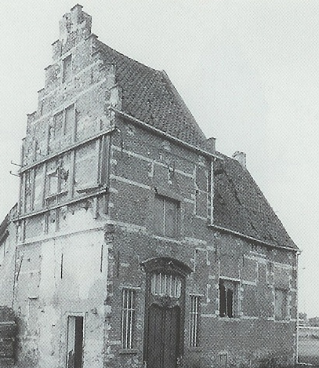






15min
REST
REpresentational State Transfer
Theoretical
Introduction
Notes:
REST: Representational state transfer

Slide 2




MENU
REST
Methods
Status Codes
JWT

Slide 3



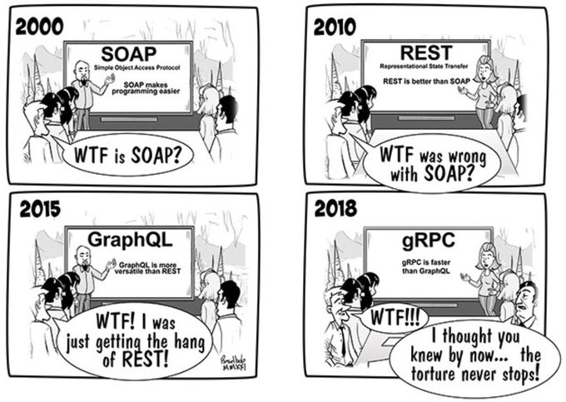

REST?

Slide 4



Methods
GET
POST
PUT
PATCH
DELETE
OPTIONS
Notes:
PATCH: Partial PUT
OPTIONS: Preflight: find out what methods a server supports (Allow header)
Other: HEAD, CONNECT, TRACE
Details: https://developer.mozilla.org/en-US/docs/Web/HTTP/Methods

Slide 5

Response Status Codes
1xx – Informational
2xx – Success
3xx – Redirection
4xx – Client errors
5xx – Server errors

Slide 6
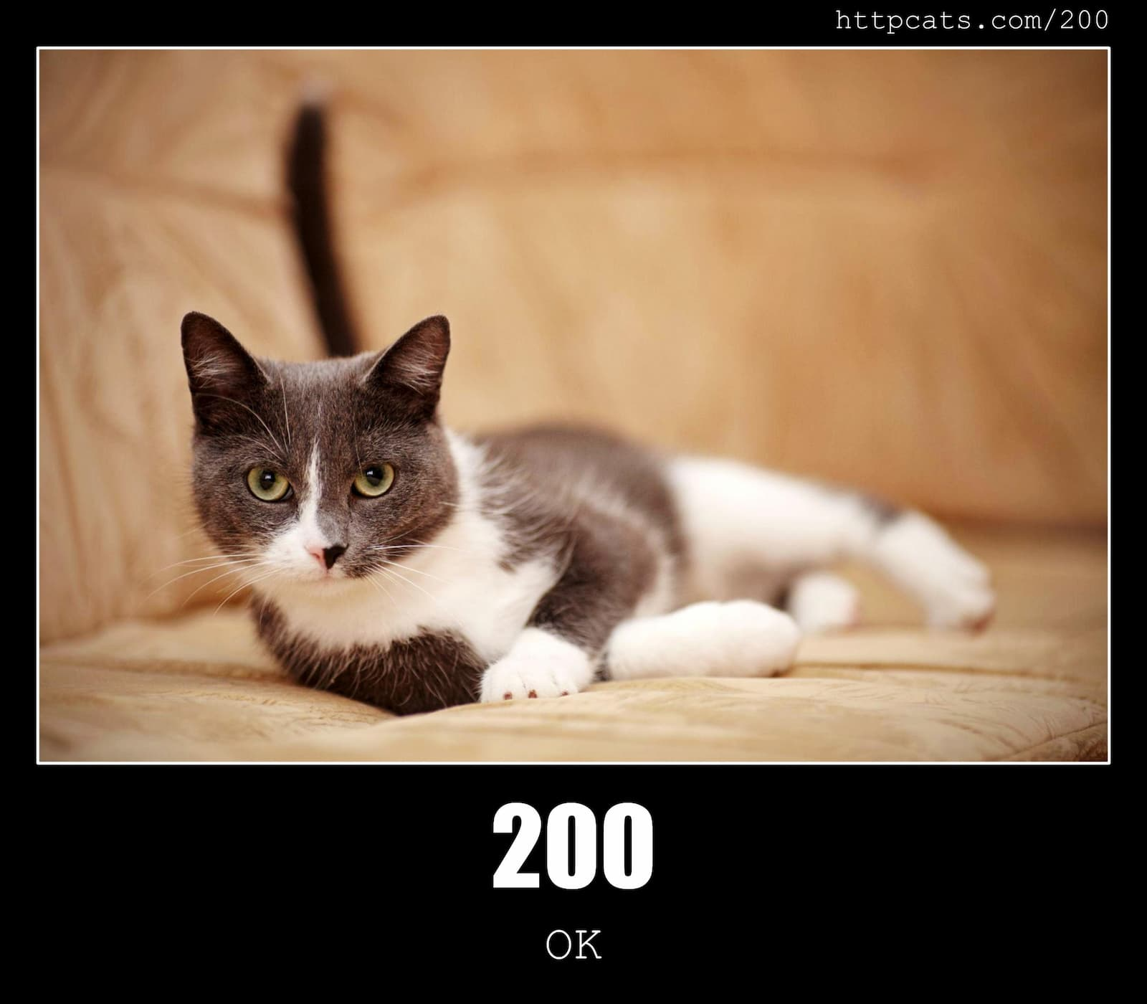
Common Status Codes
Notes:
Website: https://httpcats.com/

Slide 7
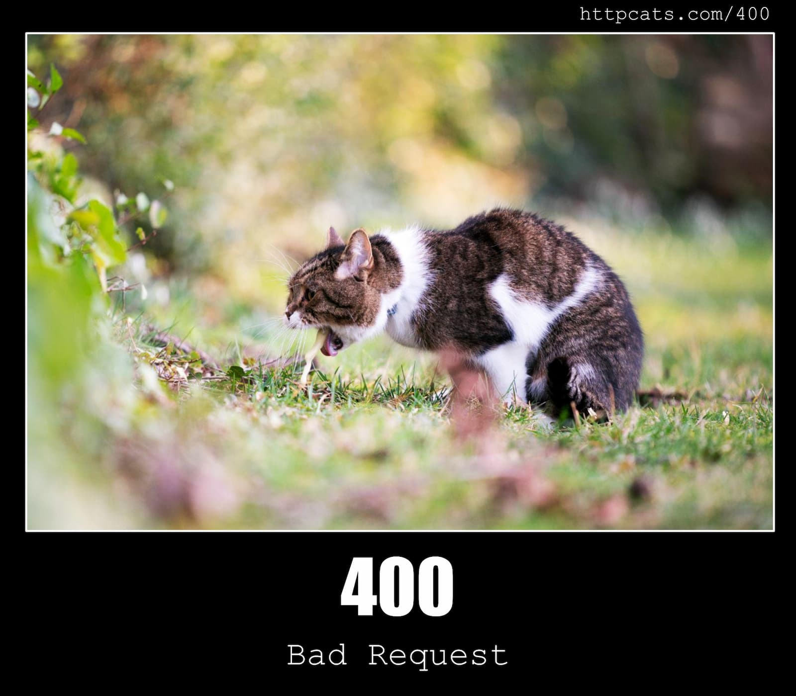
Common Status Codes

Slide 8
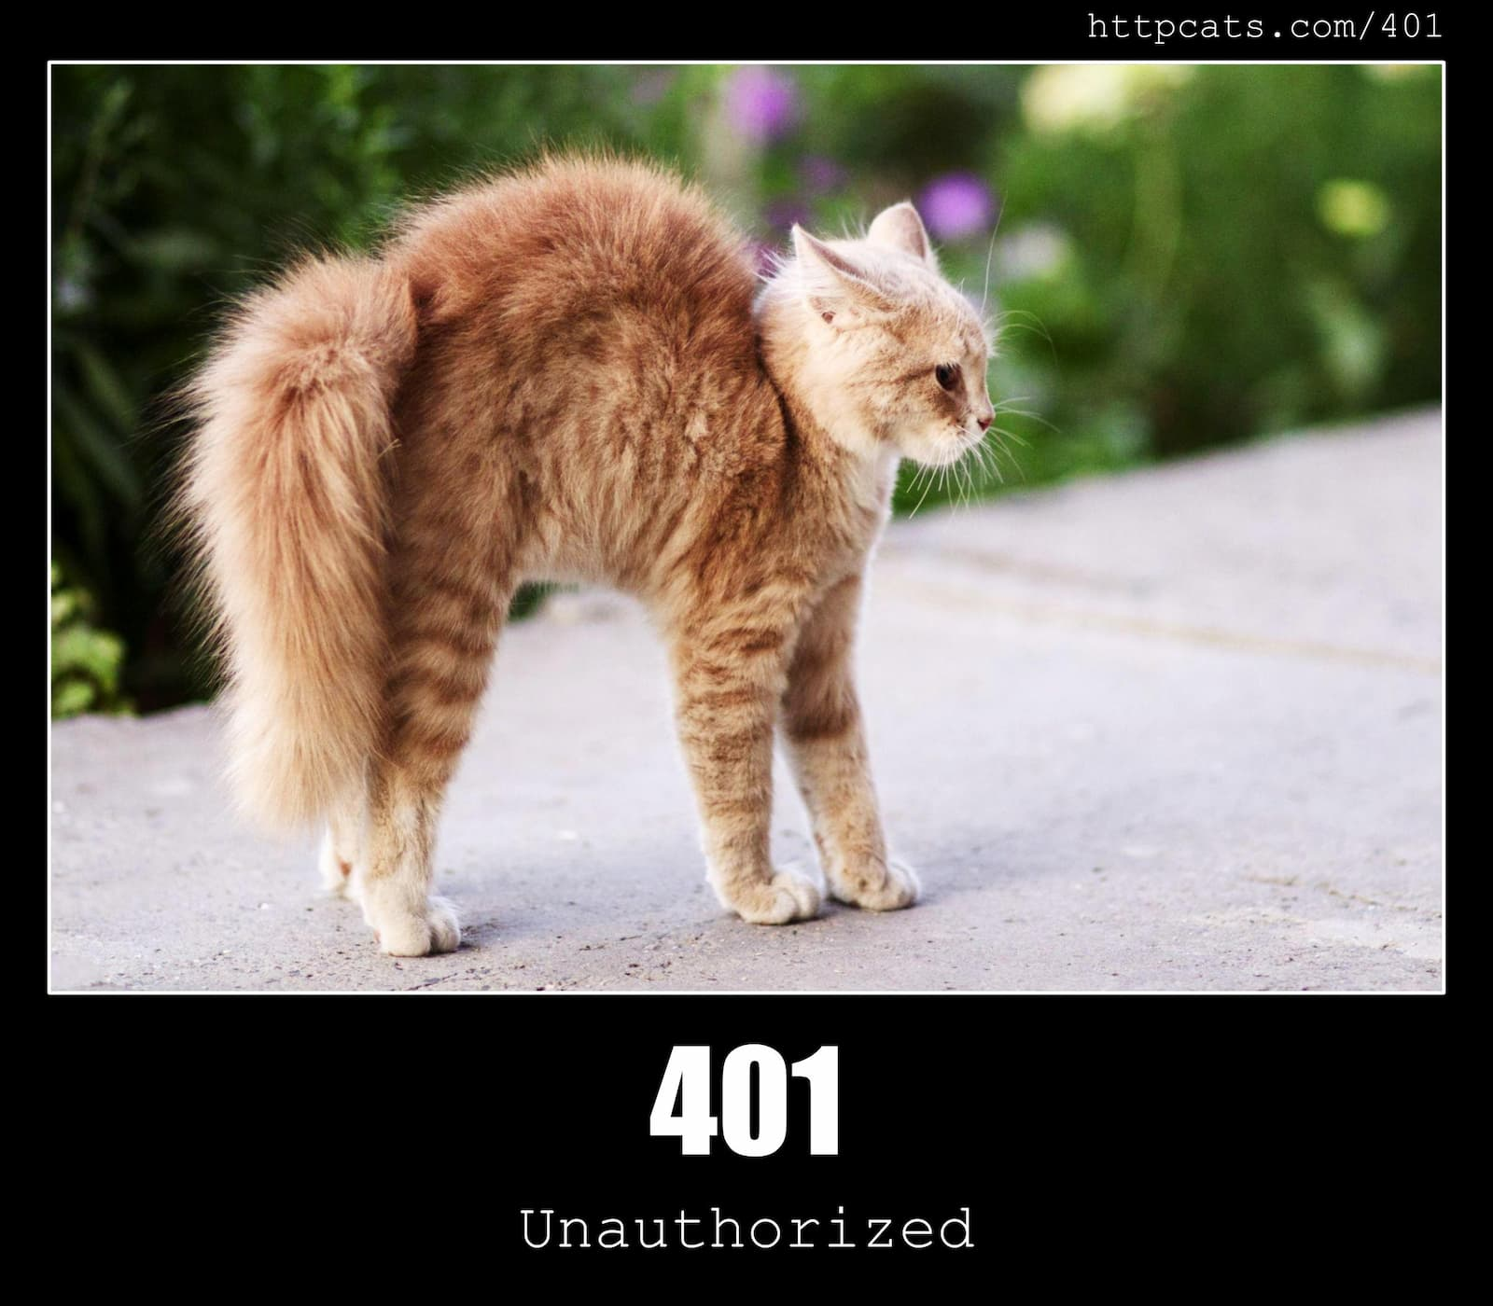
Common Status Codes

Slide 9
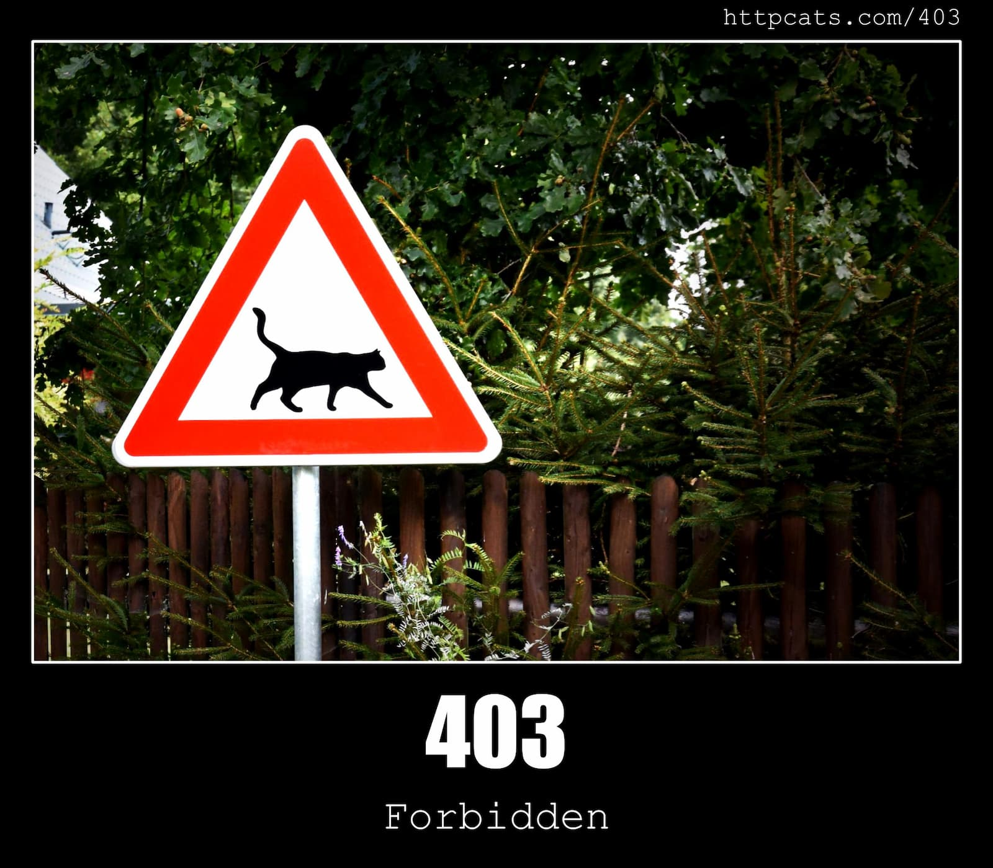
Common Status Codes

Slide 10
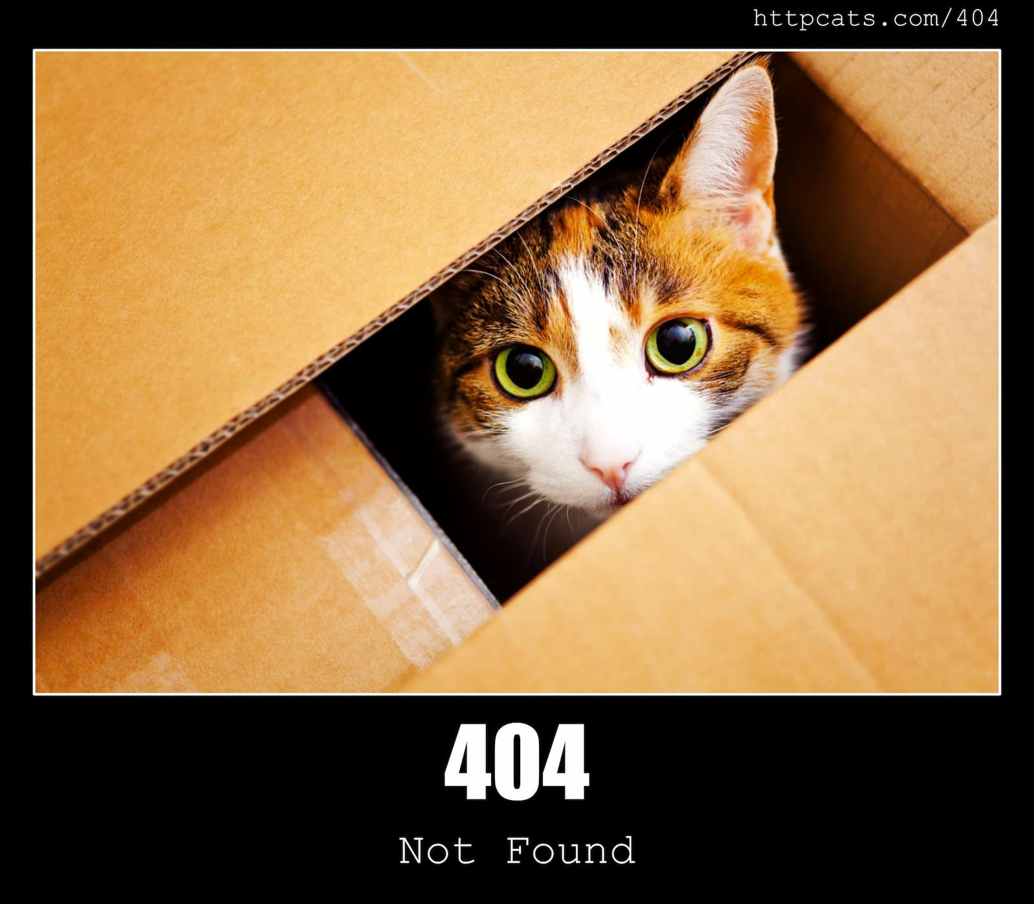
Common Status Codes

Slide 11
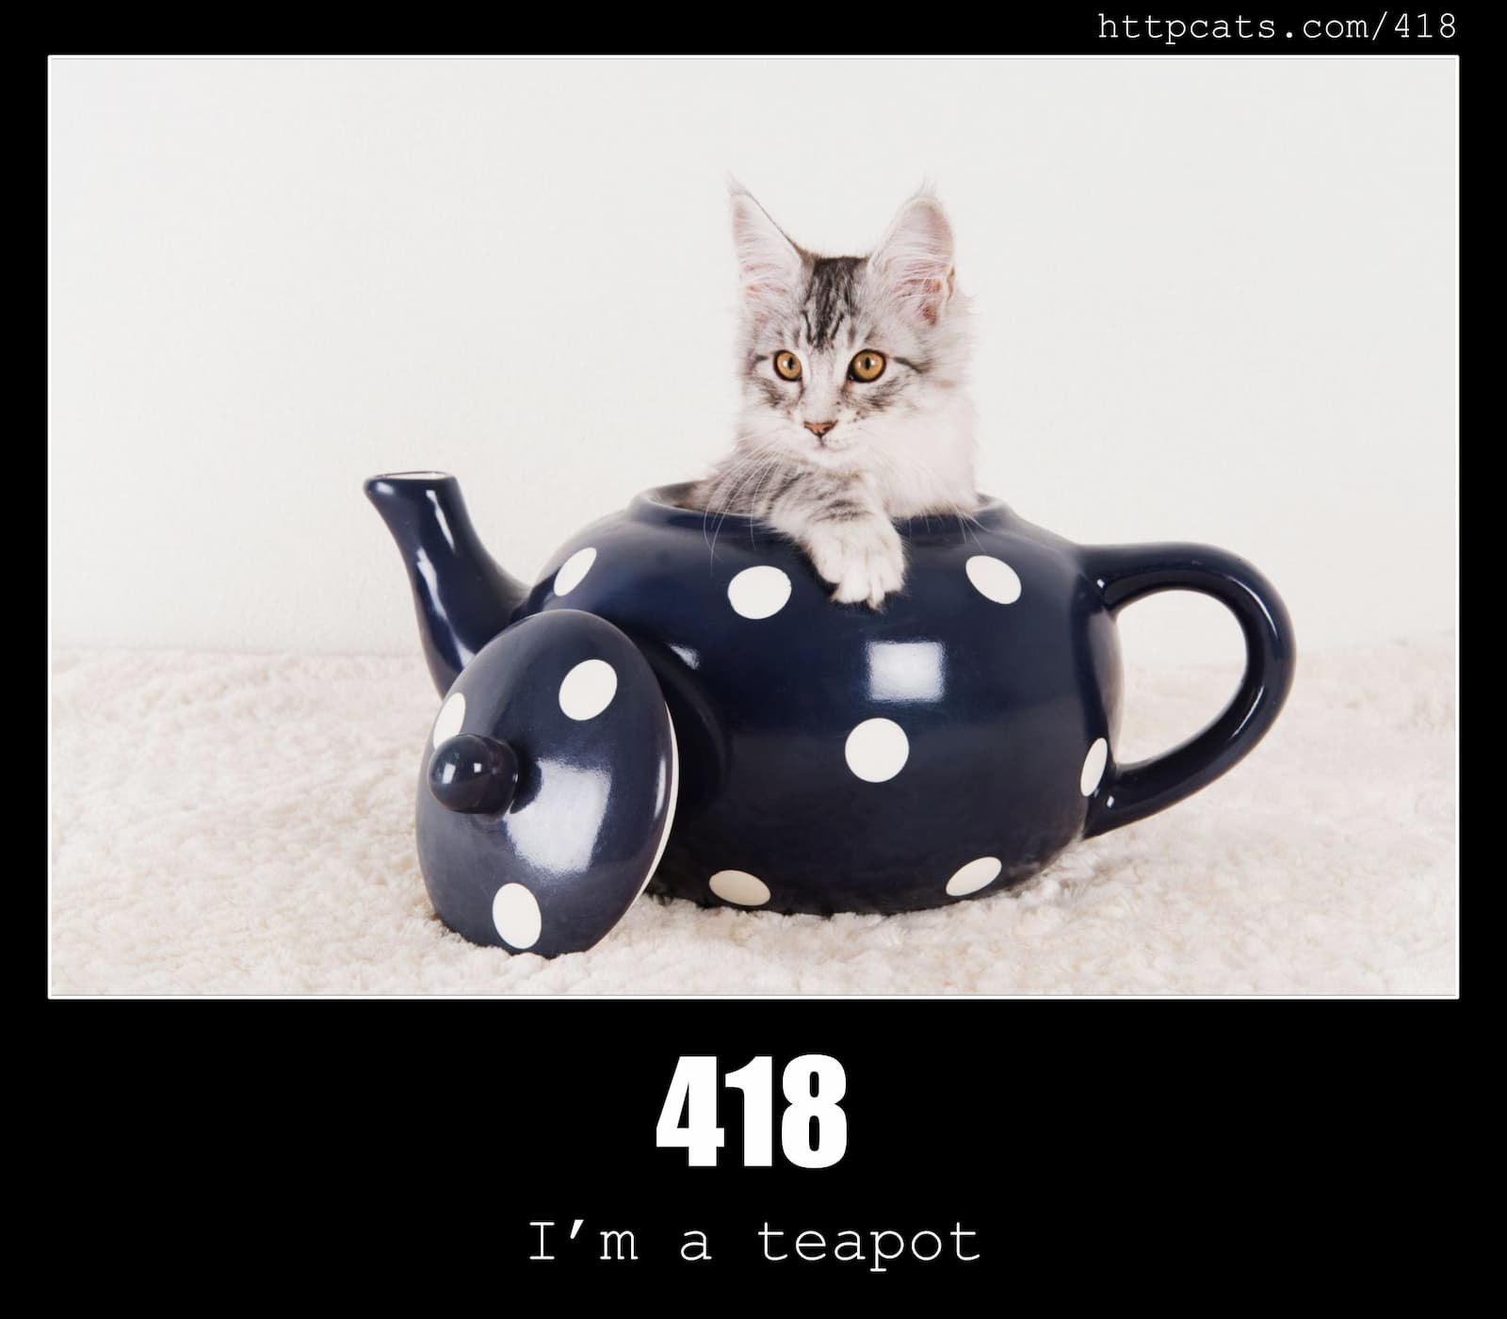
Common Status Codes
Notes:
April Fools’ joke in 1998 & 2014

Slide 12

Common Status Codes

Slide 13


Common Status Codes
200 – OK
400 – Bad Request
401 – Unauthorized
403 – Forbidden
404 – Not Found
500 – Internal Server Error
Notes:
100 Continue, 101: Switching Protocols, 102 Processing
201 Created, 202 Accepted, 204 NoContent, 206 Partial Content
300 Multiple Choices, 301 Moved Permanently, 302 Found, 303 See Other, 304 Not Modified, 307 Temporary Redirect, 308 Permanent Redirect
405 Method Not Allowed, 406 Not Acceptable, 408 Request Timeout, 409 Conflict, 411 Length Required, 413 Payload Too Large, 414 URI Too Long, 429 Too Many Requests
List: https://developer.mozilla.org/en-US/docs/Web/HTTP/Status

Slide 14



Postman… or not…
cURL
SoapUI
hoppscotch.io
Insomnia
VSCode: Thunder Client

Slide 15

So… REST?
Stateless
Typically JSON
Urls
POST /socks
PUT /socks/:sockId
Caching
Versioning

Slide 16

JWT
Json Web Token
JWT.io
Just a base64 encoded JSON
Signed with server secret

Slide 17



THANK YOU!

Slide 18
WiFi: itenium-guest / Wifi4Ufree

